Slide 1

IBM Capstone Project – Identifying the best US City to host the next Laver Cup - 2020
- By Angadvir Singh Paintal

Slide 2
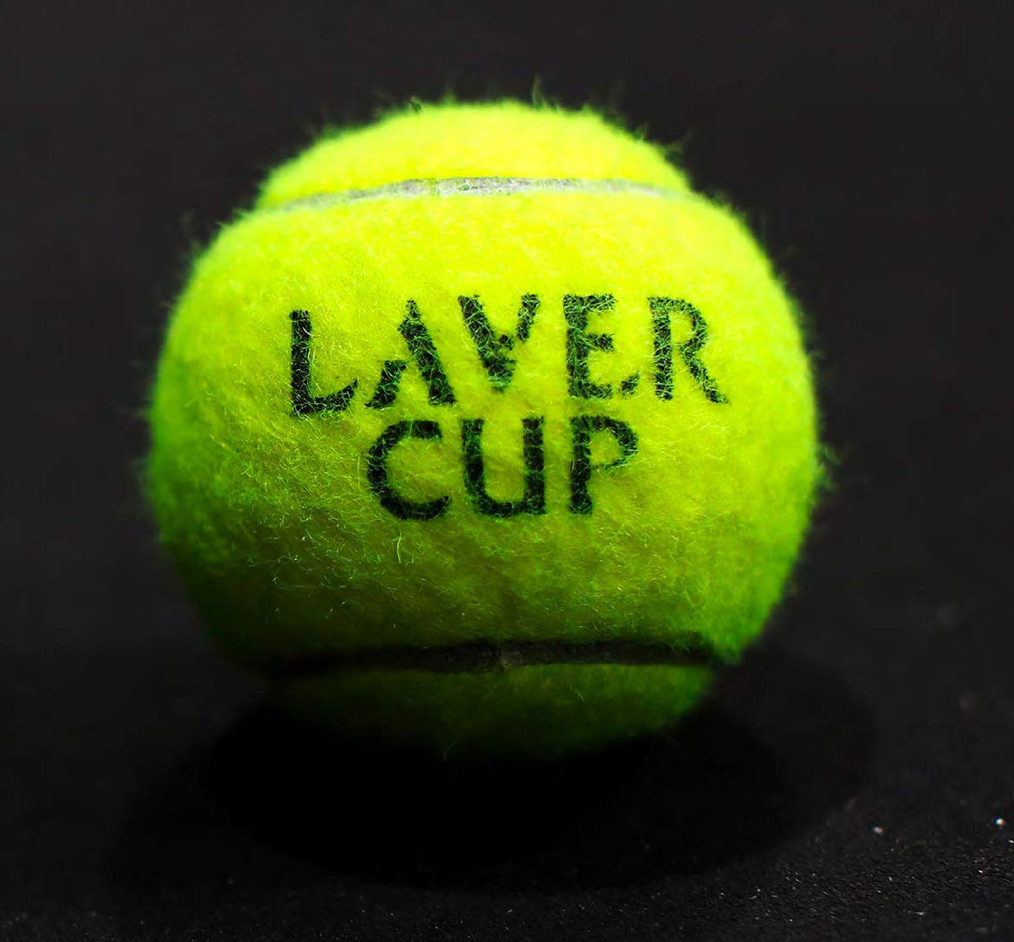
Introduction
The Laver Cup committee is tasked to identify the next best US city to host the Laver Cup, for 2020 edition of the Cup.
The preference is to choose a city which hasn’t hosted a Grand Slam event or a major ATP Tennis tournament, however, which has an arena established enough to host a grand Tennis event at a global level.
Several pre-selected US cities initially participated in a lucky draw, of which 6 cities are shortlisted for the event.
The last 6 candidate cities are listed below:
Palm Springs, CA
Phoenix, AZ
Dallas, TX
Cincinnati, OH
Boston, MA
Miami, FL

Slide 3
Introduction
Our historical data will comprise of all 4 major Grand Slam events and the cities which hosted the last 3 Laver Cups.
A K-means clustering algorithm will be implemented on all the 7 historical cities along with 6 new candidate cities.
The list of 7 cities/venues is provided below:
US Open – Flushing Meadows, Queens, NYC
Wimbledon – Wimbledon, London, UK
French Open – Phillipe Chartier Stadium, Paris, France
Australian Open – Rod Laver Arena, Victoria, Australia
Laver Cup 2017 – O2 Arena, Prague, Czech Republic
Laver Cup 2018 – United Center, Chicago, Illinois
Laver Cup 2019 – Palexpo, Geneva, Switzerland

Slide 4
Analysis – Venue categories exploration of past major tennis events
Event Venue | 1st most common venue category | 2nd most common venue category | 3rd most common venue category | 4th most common venue category | 5th most common venue category | 6th most common venue category | 7th most common venue category | 8th most common venue category
French Open | Tennis Court | Stadium | Arts & Entertainment | French Restaurant | College Classroom | Event Space | Office | Sporting Goods Shop
US Open | Tennis Stadium | General Entertainment | Clothing Store | Tennis Court | Lounge | Sporting Goods Shop | Sandwich Place | Bar
Australian Open | Event Space | Tennis Stadium | Warehouse | Tennis Court | General Entertainment | Café | Concert Hall | Food Service
Wimbledon | Platform | Coffee Shop | Bank | Fast Food Restaurant | Salon / Barbershop | Bus Stop | Grocery Store | Mobile Phone Shop
Laver Cup – Czech Republic | Lounge | Clothing Store | Sporting Goods Shop | Skating Rink | Shoe Store | Women's Store | Lingerie Store | Baby Store
Laver Cup - Chicago | Bar | Stadium | General Entertainment | Outdoor Sculpture | Basketball Stadium | Sports Bar | Hockey Arena | Parking
Laver Cup - Switzerland | Convention Center | Hotel | Event Space | Exhibit | Café | Restaurant | Parking | Bank

Slide 5
Analysis – Clustering the 7 Tennis event venues into different categories based on neighborhood similarity
Event Venue | Cluster Labels | 1st most common venue category | 2nd most common venue category | 3rd most common venue category | 4th most common venue category | 5th most common venue category | 6th most common venue category | 7th most common venue category | 8th most common venue category
French Open | 0 | Tennis Court | Stadium | Arts & Entertainment | French Restaurant | College Classroom | Event Space | Office | Sporting Goods Shop
US Open | 1 | Tennis Stadium | General Entertainment | Clothing Store | Tennis Court | Lounge | Sporting Goods Shop | Sandwich Place | Bar
Australian Open | 1 | Event Space | Tennis Stadium | Warehouse | Tennis Court | General Entertainment | Café | Concert Hall | Food Service
Wimbledon | 0 | Platform | Coffee Shop | Bank | Fast Food Restaurant | Salon / Barbershop | Bus Stop | Grocery Store | Mobile Phone Shop
Laver Cup – Czech Republic | 0 | Lounge | Clothing Store | Sporting Goods Shop | Skating Rink | Shoe Store | Women's Store | Lingerie Store | Baby Store
Laver Cup - Chicago | 0 | Bar | Stadium | General Entertainment | Outdoor Sculpture | Basketball Stadium | Sports Bar | Hockey Arena | Parking
Laver Cup - Switzerland | 0 | Convention Center | Hotel | Event Space | Exhibit | Café | Restaurant | Parking | Bank
Observation: US Open and Australian Open are found to have similar neighborhoods when types of venues are taken into consideration. They fall under the same cluster as compared to rest of the Tennis venues.
U.S. Open will be taken as a venue for similarity analysis to the 6 candidate cities in the US, based on which the final city will be selected to host Laver Cup - 2020.

Slide 6
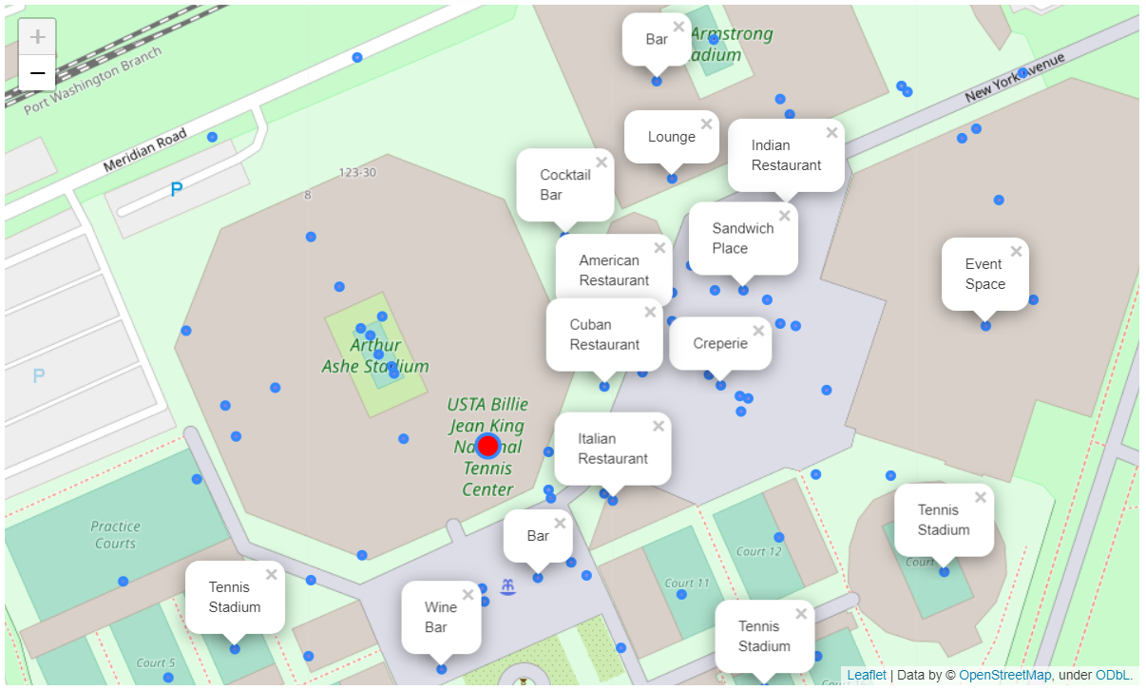
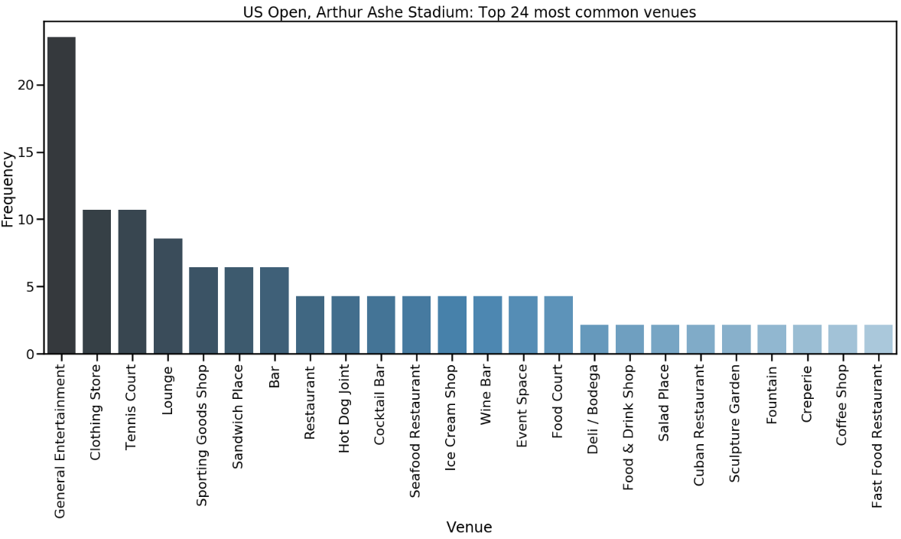
Analysis – Finding the 24 most common types of venues found near the Arthur Ashe Stadium, in Flushing Meadows, Queens, NYC

Slide 7
Analysis – Clustering the 7 Tennis event venues into different categories based on neighborhood similarity
Event Venue | Cluster Labels | 1st most common category | 2nd most common category | 3rd most common category | 4th most common category | 5th most common category | 6th most common category | 7th most common category | 8th most common category
US Open | 1 | Tennis Stadium | General Entertainment | Tennis Court | Clothing Store | Lounge | Bar | Sporting Goods Shop | Sandwich Place
Palm Spring, CA | 0 | Building | Clothing Store | Pharmacy | Sporting Goods Shop | Café | Department Store | Big Box Store | Coworking Space
Phoenix, AZ | 0 | Building | Convenience Store | Church | Mexican Restaurant | Bar | Salon / Barbershop | Automotive Shop | American Restaurant
Miami, FL | 2 | Beach | Tennis Court | Residential Building | Café | Gas Station | Office | Other Great Outdoors | Boat or Ferry
Cincinnati, OH | 2 | Tennis Court | Theme Park | Water Park | Theme Park Attraction | Office | Tennis Stadium | General Entertainment | Parking
Boston, MA | 3 | Bar | Platform | Hockey Arena | General Entertainment | Hockey Field | Lounge | Pizza Place | Sporting Goods Shop
Dallas, TX | 3 | Bar | Sports Bar | Lounge | Event Space | Parking | Office | Residential Building | Italian Restaurant
Observation: Each of the 6 candidate cities is found to be in a cluster different from that of the ‘US Open’. We will look into each of the 6 candidate cities which were shortlisted in the draw, to analyze to choose the best city to host the Cup.

Slide 8
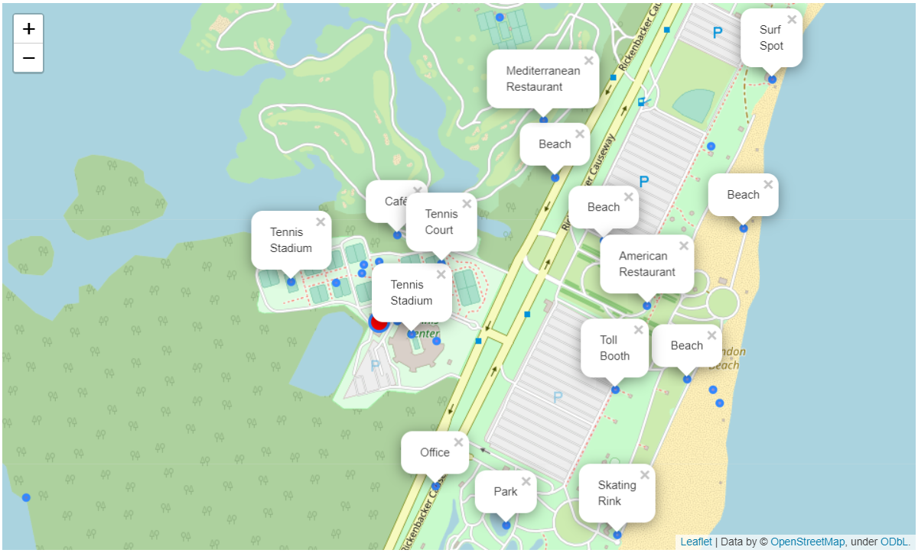
Analysis – Analyzing each of the 6 candidate cities
Miami, Florida – Crandon Park Tennis Stadium:
The Crandon Park Stadium currently holds a crowd of approximately 13,500. Also looking at the neighborhood of the stadium, it is pre-dominantly surrounded by beaches and Tennis courts, and does not have a high concentration of bars, cafés or international restaurants, like the US Open.
Considering the above factors, the Florida State committee will need to embark on a significant expansion project to develop and ready Tennis fan at a global level. Considering only 8 months are left to host the 2020 Laver Cup, it may be too small of a time horizon for the Florida State to complete this expansion and neighborhood re-development in time.
Hence, Miami is dropped as a candidate city for hosting this year’s Laver Cup.

Slide 9
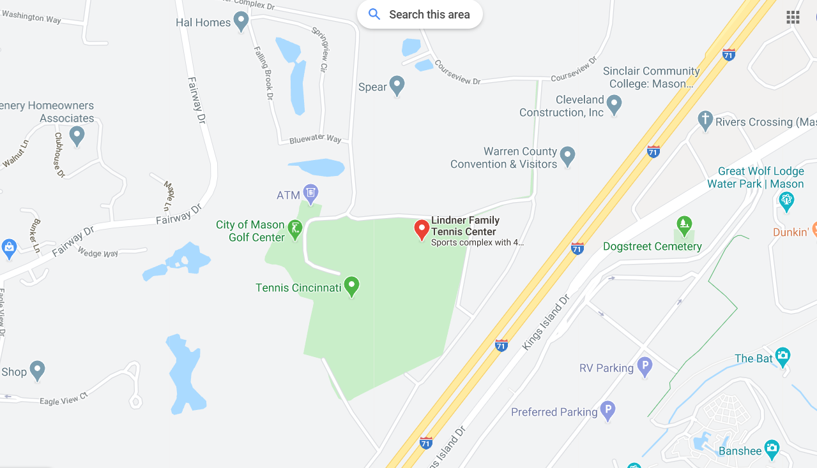
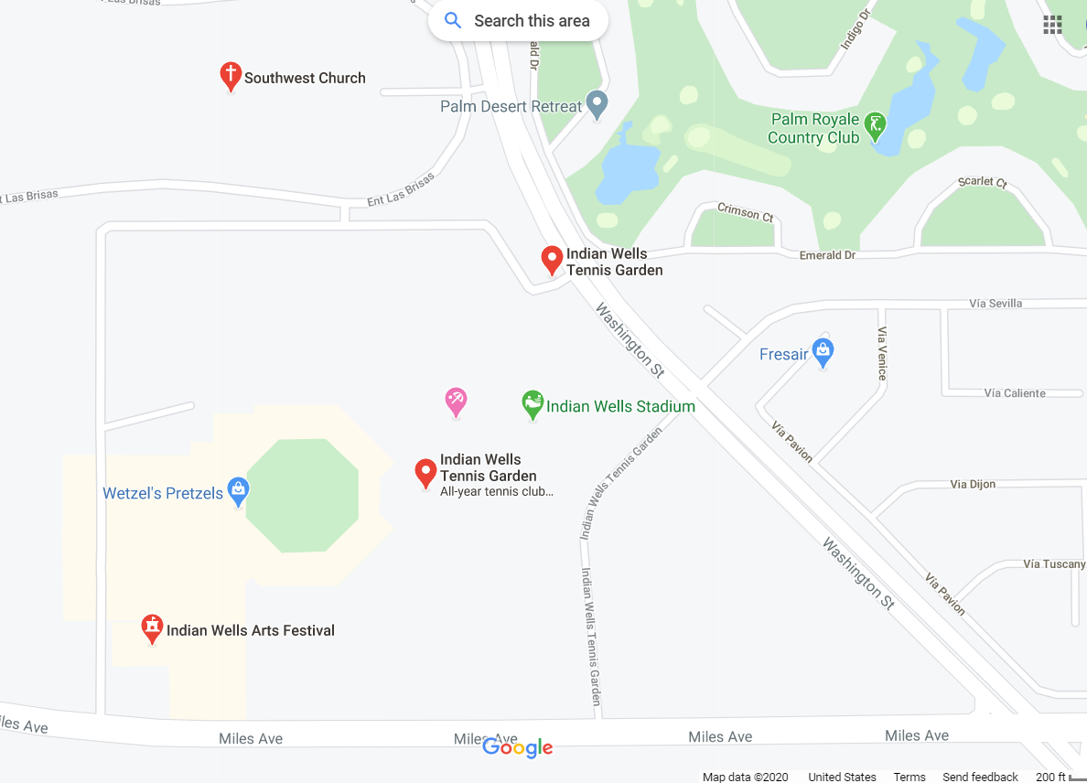
Analysis – Analyzing each of the 6 candidate cities
Cincinnati, OH and Palm Springs (Indian Wells), CA are home to major ATP tournaments and regions have a strong fan base when it comes to Tennis.
Since the Laver Cup committee has a preference to host the Laver Cup event at a city which has not yet hosted a major Tennis tournament, the committee will choose a new city to host this year’s, 2020 Laver Cup, to propagate the sport of Tennis in the host city and its surrounding neighborhoods and suburbs.
Moreover, both Cincinnati and Indian Wells Tennis Centers are in a suburban area, far from the city centers. Another criteria, that the committee is interested in considering when it comes to venue selection for the Laver Cup.
Cincinnati Open
Indian Wells Open

Slide 10
Analysis – Analyzing each of the 6 candidate cities
After dropping off Miami, Cincinnati and Palm Springs (Indian Wells) from the list, we’re left with the below list of candidate cities:
Event Venue | Cluster Labels | 1st most common category | 2nd most common category | 3rd most common category | 4th most common category | 5th most common category | 6th most common category | 7th most common category | 8th most common category
US Open | 1 | Tennis Stadium | General Entertainment | Tennis Court | Clothing Store | Lounge | Bar | Sporting Goods Shop | Sandwich Place
Phoenix, AZ | 0 | Building | Convenience Store | Church | Mexican Restaurant | Bar | Salon / Barbershop | Automotive Shop | American Restaurant
Boston, MA | 3 | Bar | Platform | Hockey Arena | General Entertainment | Hockey Field | Lounge | Pizza Place | Sporting Goods Shop
Dallas, TX | 3 | Bar | Sports Bar | Lounge | Event Space | Parking | Office | Residential Building | Italian Restaurant

Slide 11
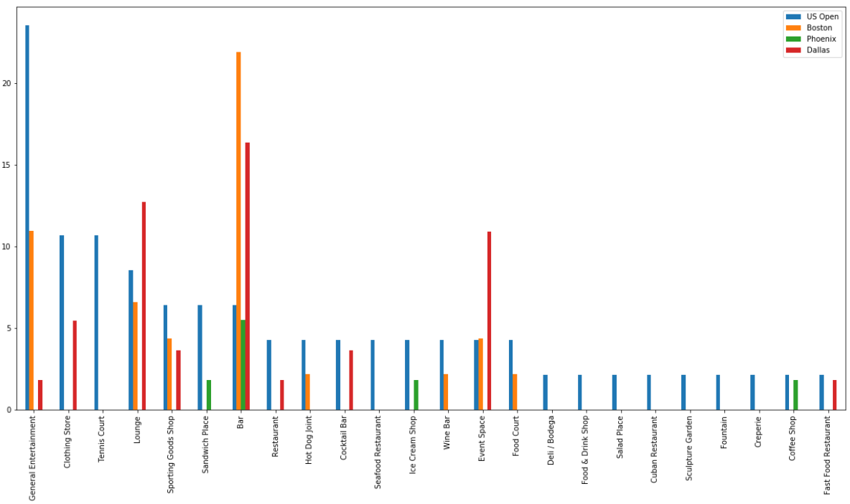
Comparing top 24 venue types found in US Open against 3 remaining candidate cities: U.S. Open venues vs Boston, Phoenix and Dallas venues

Slide 12
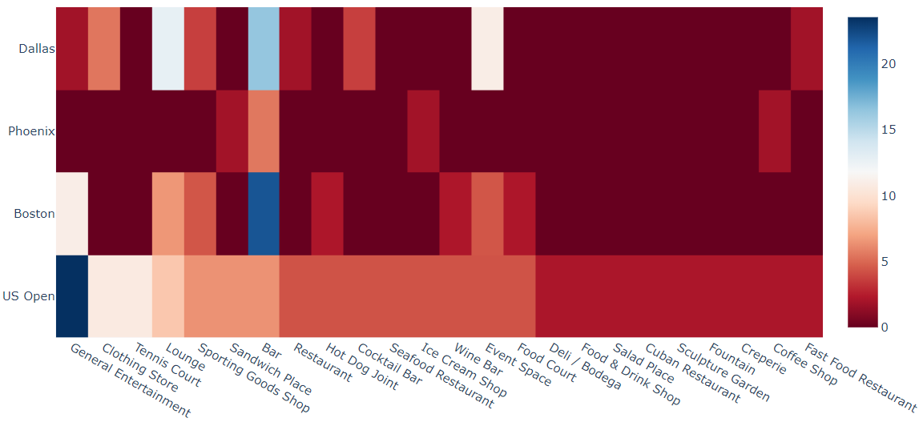
Comparing top 24 venue types found in US Open against 3 remaining candidate cities: U.S. Open venues vs Boston, Phoenix and Dallas venues Heat Map Visualization

Slide 13
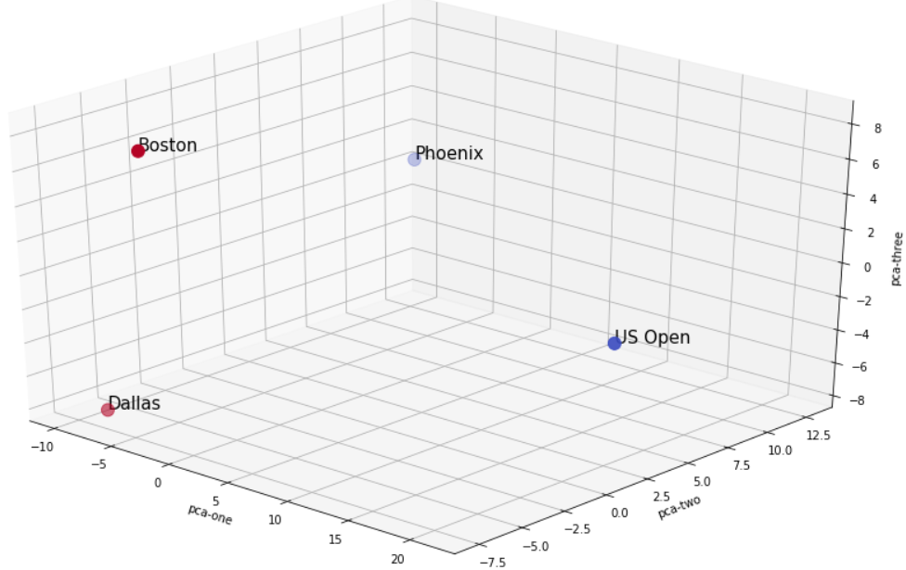
Comparing top 24 venue types found in US Open against 3 remaining candidate cities: U.S. Open venues vs Boston, Phoenix and Dallas venues
After performing PCA on the dataset and reducing the dimensionality of the features space to 3 dimensions, below results are found post running the un-supervised K-Means algorithm on the dataset:
The ‘Arizona Memorial Sports Stadium’ and ‘Arthur Ashe Stadium’ in Flushing Meadows are clustered together in the same set, showing to have similar neighborhoods, as seen in blue data points.
The ‘TD Garden’ in Boston and ‘American Airlines Center’ in Dallas are clustered together and found to have similar neighborhoods when comparing venue categories, as seen by the red data points.

Slide 14
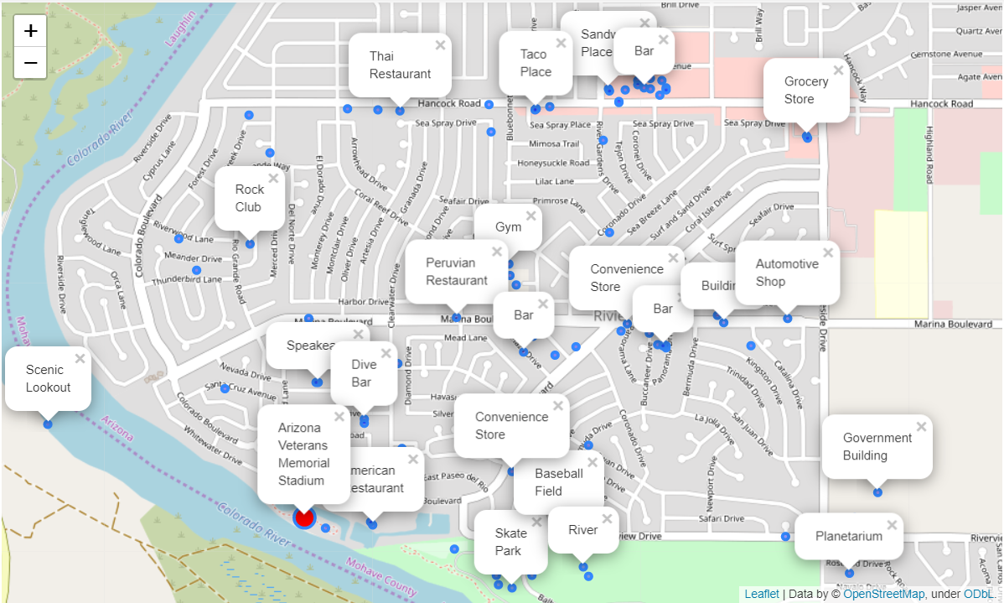
Comparing venues categories found around ‘Arizona Veterans Memorial Stadium’ against those found around U.S. open, around ‘Arthur Ashe Stadium’
The 4 venue categories found most common around the 2 city Tennis stadiums are:
‘Sandwich places', 'Coffee Shops', 'American Restaurants' and 'Bars’
These 4 venue types are very conducive of a touristy environment and encourage a very strong celebratory sports cultures in the host city.
Phoenix, AZ: Arizona Veterans Memorial Stadium
U.S. Open: Arthur Ashe Stadium

Slide 15

Conclusion
The Multi-sport stadium in Phoenix, AZ is one of the best locations for the respective Tennis Federation / Organization to host the next Laver Cup, to be hosted in 2020*. Since the neighborhood, in terms of the types of venues around the stadium, is most similar to that of the U.S. Open stadium in Flushing Meadows (both 'US Open' and 'AZ' state fall under the same cluster), there's expected to be a good turn-around of tennis fans to watch and support the intensive and celebratory 3-Days Laver Cup event, initiated by Roger Federer and Rod Laver.
On visualizing the neighborhood of Phoenix, AZ, we find a very similar city and landscape to that of U.S. Open venue, around the ‘Arthur Ashe Stadium’.
The same can be observed when comparing the Euclidian distance of the ‘Phoenix’ data point to that of ‘US Open’ in the 3-D projected graph utilizing Principal Component Analysis. Note, the Euclidian distance between ‘Boston’ and ‘Dallas’ from that of ‘US Open’ is greater and hence are categorized together in a separate cluster.

